Slide 1
“Impact of extreme heat events on health”
Dr. Meena Som, Health Specialist, UNICEF-HFO
^{24th March 2018}

Slide 2
Problem Statement
Occurrence of extreme heat events has significantly increased across the country due to climate change
India is among the worst disaster prone countries
In the past few years temperatures ranging from 44 to 48 deg C across various cities has been seen. More than 2000 deaths have been seen in some years
Extreme temperatures coupled with humidity and atmospheric conditions leads to stress and affects the body
Better preparedness can help mitigate the impact on human and animal health

Slide 3
Impact on health
Human body temperature is 37 deg C
When temperature increases more than 37 deg C, the body starts gaining heat from atmosphere
If the humidity is high heat stress may happen at 37 or 38 deg C
People engaged in occupations where they have to work outside and are exposed to heat as well as elderly and children are more vulnerable

Slide 4
Clinical conditions
Sunburn
Symptoms: Skin redness and pain, possible swelling, blisters, fever, headaches.
First Aid: Bath using soap, If blisters occur get medical attention
Heat Cramps
Symptoms: Painful spasms usually in leg and abdominal muscles or extremities. Heavy sweating
First Aid: Move to cool or shaded place. Apply firm pressure on cramping muscles or gentle massage to relieve spasm. Give sips of water.

Slide 5
Clinical conditions
Heat Exhaustion
Symptoms: Heavy sweating, weakness, skin cold, pale, headache and clammy, Weak pulse, Normal temperature possible, Fainting, vomiting
First Aid: Move to cool or shaded place, Apply cool, wet cloth, provide fan or AC. Give sips of water slowly. If vomiting occurs, seek immediate medical help
Heat Stroke
Symptoms: High body temperature, (106+F). Hot, dry skin, Rapid, strong pulse, Possible unconsciousness, may not sweat
First Aid: It is an emergency, refer immediately, Delay can be fatal, Move to cool or shaded place, Apply cool, wet cloth, provide fan or AC, fluids not required

Slide 6
Do’s
Be aware of the local weather forecast (Radio, TV, News papers)
Drink sufficient water frequently, carry water during travel, provide drinking water near work place
Wear lightweight, light coloured, loose, cotton clothes.
Avoid direct sunlight, use umbrella, damp cloth on your head, shoes or chappals while going out in sun or working outside.
Use ORS, homemade drinks like lassi, kanji (rice water), lemon water, buttermilk, etc, which help to re-hydrate the body.
Recognize the signs of heat stroke, heat rash or heat cramps such as weakness, dizziness, headache, nausea, sweating, seek medical help.
Keep home cool, use curtains, shutters or sunshade and open windows at night.
Schedule strenuous outdoor work to early morning or evening cooler

Slide 7
Dont’s
Avoid going out in the sun, especially between 12.00 noon and 3.00 p.m.
Avoid wearing dark, heavy or tight clothing.
Avoid strenuous activities when the outside temperature is high.
Avoid cooking during peak hours. Open doors and windows to ventilate cooking area adequately.
Avoid alcohol, tea, coffee and carbonated soft drinks, which dehydrates the body.
Avoid high-protein food and do not eat stale food

Slide 8
Lessons Learnt – Preparedness
Recognize Heat Wave as a major Health Risk.
Map out the 'High Risk' Communities.
Setting up of 'Public Cooling Places'.
Issue Heat wave alerts through different media.
Demarcating heat stroke wards in health facilities & adequate preparedness
Capacity building of frontline workers – ASHA, ANM, AWW
Preventive actions – home visits, community meetings
Training on: Signs and symptoms, Immediate action
Supply: Logistics (ORS), drugs, clean drinking water, information leaflets
Information: Where to refer in case of danger signs
Identify modality for emergency transport “108”, 104”, ice packs in transport vehicles
Reporting

Slide 9
Lessons Learnt – Preparedness
Special precautions for children, pregnant women, women construction / daily wage workers, elderly and those with other medical conditions. They are more vulnerable
AWCs and Schools – early opening of AWCs and schools; keep children indoors, encourage children to drink more fluids, NOT soft drinks, Posters with do’s and dont’s, cooking in AWCs to be done early morning
Key points to be told to children in schools
Do not leave children in parked vehicles.
Change timings for construction workers, may start early morning

Slide 10
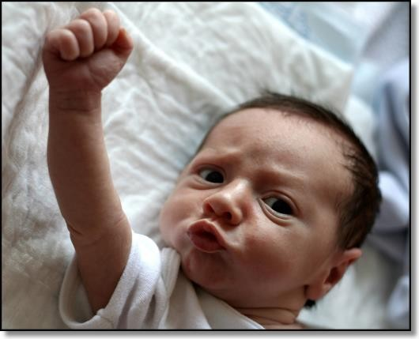
Now is the time for urgent …..
Action !!!

